Slide 1
CS-2001 Data Structures
AVL Trees
Week 12| Lecture 31-33

Slide 2
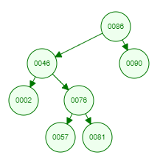
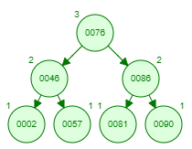
AVL Trees
AVL tree is a self-balancing Binary Search Tree (BST) where the difference between heights of left and right subtrees cannot be more than one(1) for all nodes. This difference is called the Balance Factor.
BS Tree
AVL Tree

Slide 3
Rotations in AVL Trees
To maintain the balance in AVL tree, we perform Rotations. Depending on different imbalance cases, we have 4 basic types of rotations –
LEFT LEFT Imbalance/case (RIGHT Rotation)
RIGHT RIGHT Imbalance/case (LEFT Rotation)
LEFT RIGHT Imbalance/case (LEFT RIGHT Rotation)
RIGHT LEFT Imbalance/case (RIGHT LEFT Rotation)

Slide 4
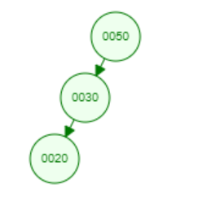
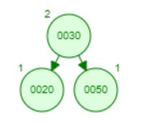
Right Rotation
Left Left Imbalance
Right Rotation

Slide 5
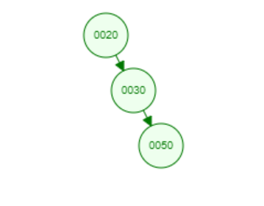
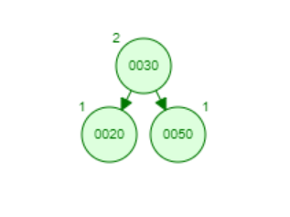
Left Rotation
Right Right Imbalance
Left Rotation

Slide 6
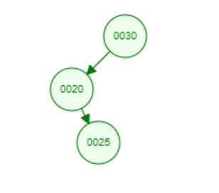
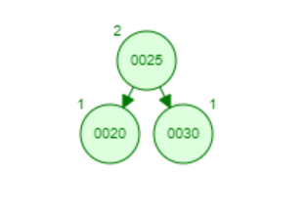
Left Right Rotation
Left Right Imbalance
Left Right Rotation

Slide 7
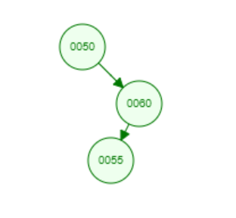
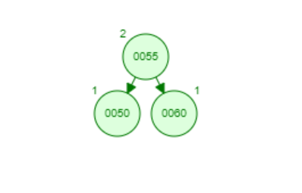
Right Left Rotation
Right Left Imbalance
Right Left Rotation

Slide 8
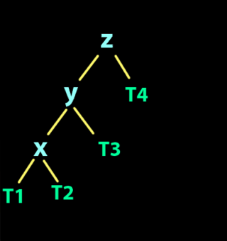
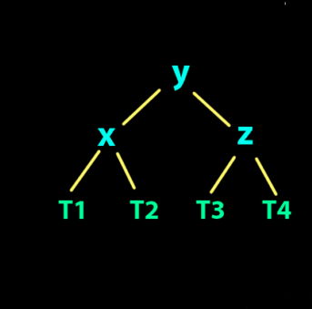
Right Rotation
Left Left Imbalance
Right Rotation

Slide 9
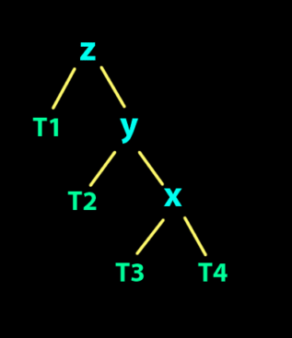
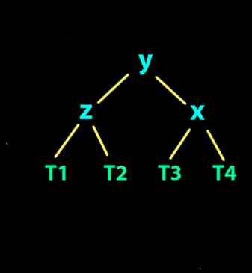
Left Rotation
Right Right Imbalance
Left Rotation

Slide 10
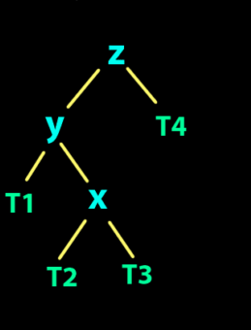
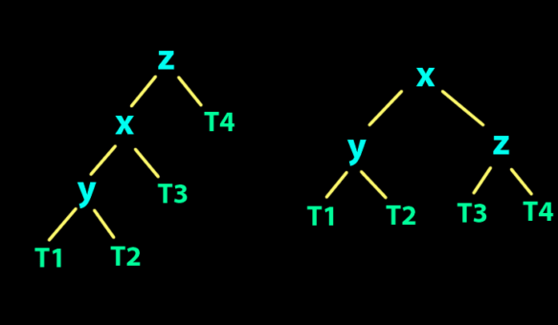
Left Right Rotation
Left Right Imbalance
Left Right Rotation

Slide 11
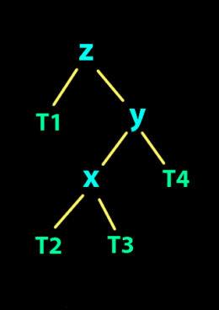
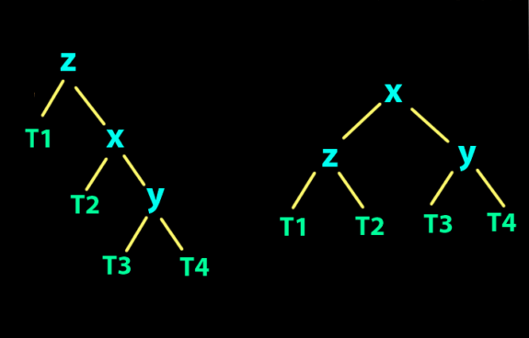
Right Left Rotation
Right Left Imbalance
Right Left Rotation

Slide 12
Insertion in AVL
TreeNode* insertRecursive(TreeNode *r, TreeNode *new_node)
IF r==NULL
THEN → r=new_node
Return r
IF new_node→value LESS THAN r→value
THEN→ r→left = insert(r→left,new_node)
ELSE IF new_node→value GREATER THAN r→value
THEN → r→right = insert(r→right,new_node)
ELSE
PRINT("No duplicate values")
Return r
bf = getBalanceFactor(r)
IF bf >1 AND new_node→value <r→left→value
return rightRotate(r)
IF bf <-1 && new_node→value > r→right→value
return leftRotate(r)
IF bf> 1 && new_node→value > r→left→value
R→left = left Rotate(r→left)
return rightRotate(r)
IF bf < -1 && new_node→value <r→right→value
R→right = rightRotate(r→right);
return left Rotate(r)
Return r
int getBalanceFactor(TreeNode *n)
{
IF (n == NULL)
return -1;
ELSE
return (height(n→left) - height(n→right))
}
TreeNode *rightRotate(TreeNode *y)
{
TreeNode *x = y→left;
TreeNode *T2 = x→right;
// Perform rotation
x→right = y;
Y→left = T2;
return x;
}
TreeNode *leftRotate(TreeNode *x)
{
TreeNode *y=x→right;
TreeNode *T2 = y→left;
// Perform rotation
Y→left = x;
X→right = T2;
return y;
}

Slide 13
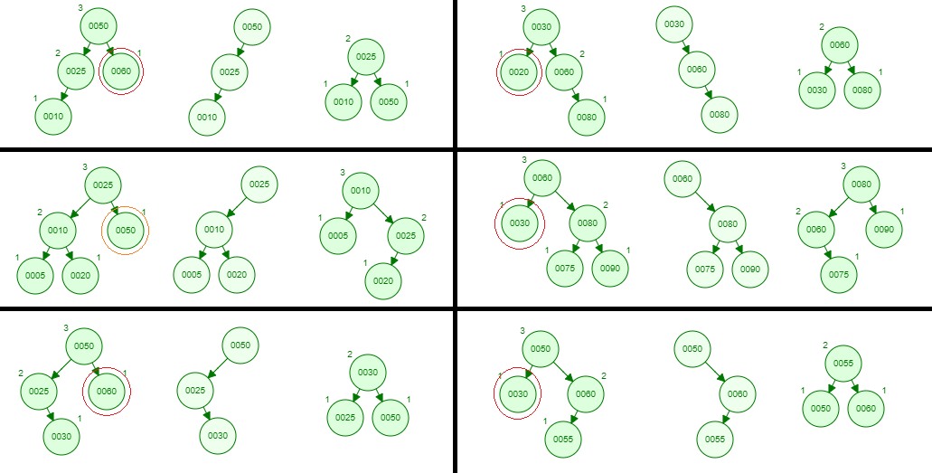
Deletion cases in AVL
For BF==2 every node Not >2 because its AVL not BST | For BF==-2 every node Not <-2 because its AVL not BST

Slide 14
Deletion in AVL
TreeNode* deleteNode(TreeNode* r, int v) {
IF r==NULL THEN →return r
ELSE IF v <r→value
THEN → r→left = deleteNode(r→left, v)
ELSE IF v > r→value
THEN → r→right = deleteNode(r→right, v)
ELSE //if value matches
IF r→left==NULL THEN → //node with only right child temp = r→right //OR no child
delete r
return temp
ELSE IF r→right==NULL THEN → // node with only left child
temp = r→left //OR no child
delete r
return temp
ELSE // node with TWO children
temp = minValueNode(r→right)
r→value = temp→value
right = deleteNode(r→right, temp→value)
bf = getBalanceFactor(r)
IF bf == 2 AND getBalance Factor(r→left) >=0
return rightRotate(r)
ELSE IF bf == 2 AND getBalanceFactor(r→left) == -1
R→left = left Rotate(r→left)
return right Rotate(r)
ELSE IF bf ==-2 AND getBalanceFactor(r→right) <=0
return left Rotate(r)
ELSE IF bf == -2 && getBalance Factor(r→right) == 1
R→right = rightRotate(r→right);
return left Rotate(r)

Slide 15
BST vs AVL Tree
Binary Search Tree | AVL Tree
When application involves less amount of data. | When searching on the higher priority
Insertion and deletion are easy because no rotations are required in binary search tree. | Insertion and deletion are complex in AVL tree as it requires multiple rotations to balance the tree.
Searching in binary search tree is less efficient as compared to AVL tree. | Efficient searching can be done by AVL tree because it is strictly balanced.
All binary search can’t be an AVL tree because either they can be balanced or unbalanced. | AVL tree also be a kind of binary search tree because an AVL tree follows conditions of binary search tree.
In binary search tree, it does not contain any balance factor. | Each node has a balance factor in AVL tree whose value can be 1, 0, or -1. It requires extra space to store the balance factor per node.
The time complexity of binary search tree could be O(n) in worst case if binary search tree is skewed either left or right side. | The time complexity of AVL tree is O(log n) because it is strictly balanced tree.

